Slide 1
Bias Complexity TradeOff
Unit 5

Slide 2


Slide 3


Slide 4


Slide 5
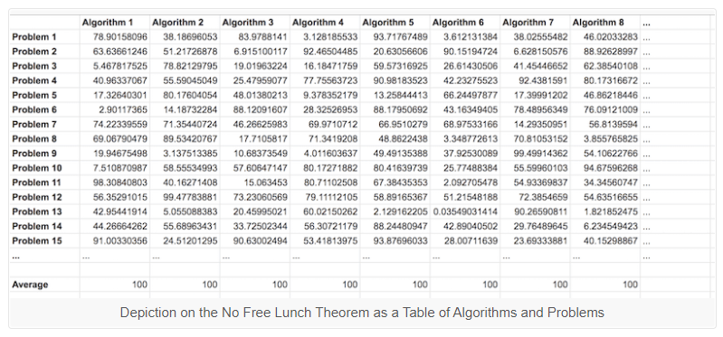
No free Lunch Theorem
The No Free Lunch Theorem, often abbreviated as NFL or NFLT, is a theoretical finding that suggests all optimization algorithms perform equally well when their performance is averaged over all possible objective functions.

Slide 6


Slide 7


Slide 8

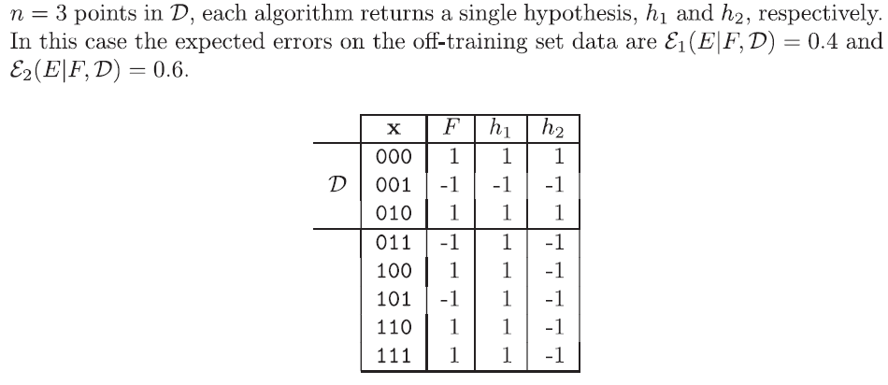
53

Slide 9



Slide 10



s

Slide 11





Slide 12
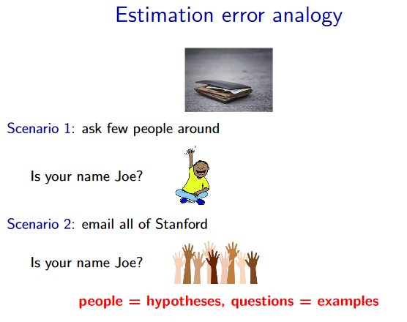

Slide 13
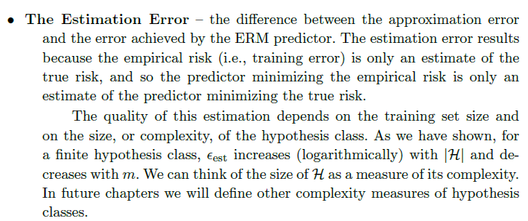

Slide 14
Thanks!!!

